Slide 1
DA_P557 SUPPLY CHAIN Management – GROUP 6
Team –
  Prashant Barde
  Adarsh Kumar
  Sindhu Naga
  Rini Chhabra
  Mabel Raymond
  Sahil Gupta
  Suraj Golesar

Slide 2
Agenda – To study supply chain data from last 3 year and study the business progress to make output on how to grow the business sales and to study challenges the business faces.
Objective – To Analyze Supply chain data from last 3 year to conclude the how business is performing and steps to be taken to improve the Sales.
Agenda & Objective
MTD, YTD, QTD – Observations
All Other KPI’s- Visuals
Dashboards
Challenges

Slide 3


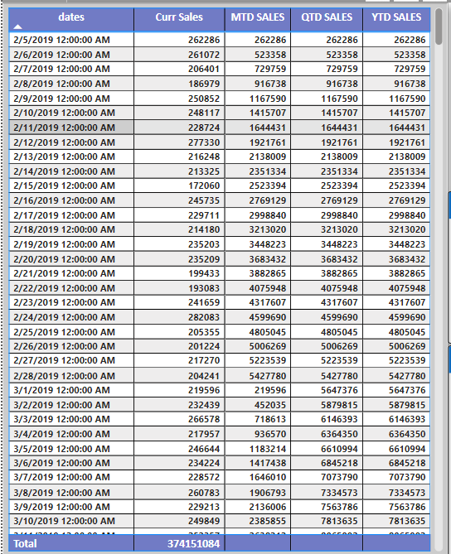
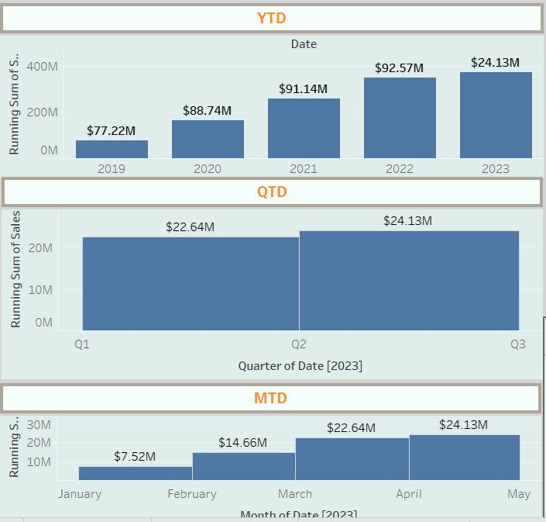
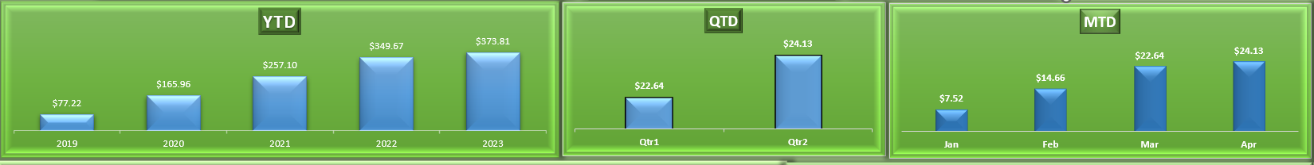



Observations:
  As seen in Year Till date sales – from last 3 Years – Sales has been exponentially increases.
  Growth was 14% from 2019 – 2020 and then it got slipped down to only 2% growth in next couple of years.
  Monthly Sales was always steadily increasing from 2019 but, its observed that in moths of July and December there is fall in sales for every Year, but it gets covered up with next month – no impacting overall performance.
  Quarterly accounting looks good though as Sales catches monthly sales dip catches up in next month – it shows exponential increase in sales.
YTD, QTD, MTD – Sales:
Business Solutions:
  To improve Sales – as seen Sales Exponentially decreased after 2019 by 12%, we need keep all required inventory in stock with us
  And as seen month of July and December we saw a bit fall in sales in past years, so we could put some extra efforts to get more customer calls
  We should make some extra customer call and may be come up with some scheme that will make customers to order more in those months
  We can focus on the sales for mobiles, computers, Entertainment products more as these were our low selling products
  The top 5 stores that gives us most sales are in Florida and Rhode island, Alabama, Louisiana and North Carolina – we should make sure inventory in these store never goes under stock.

Slide 4
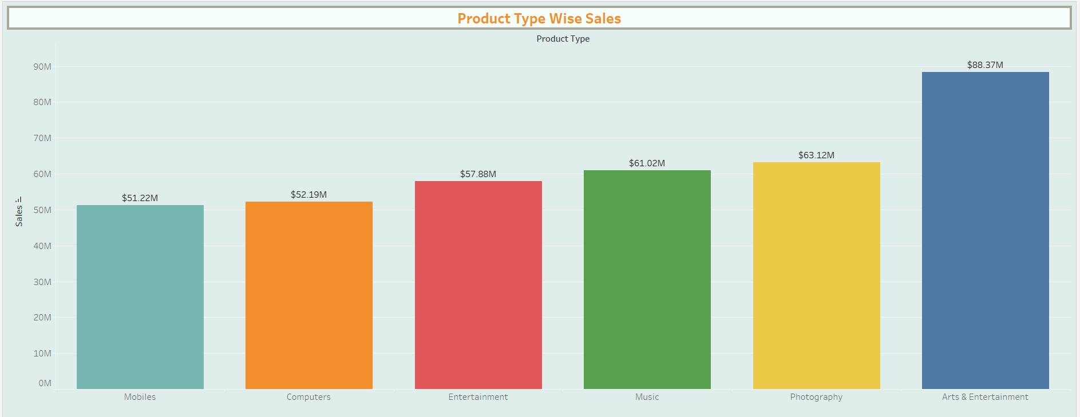
2. Product Wise Sales:
Product wise sales shows the performance of different product Types in Sales it shows our top three performing product types are:
Arts & Entertainment
Photography
Music

Slide 5
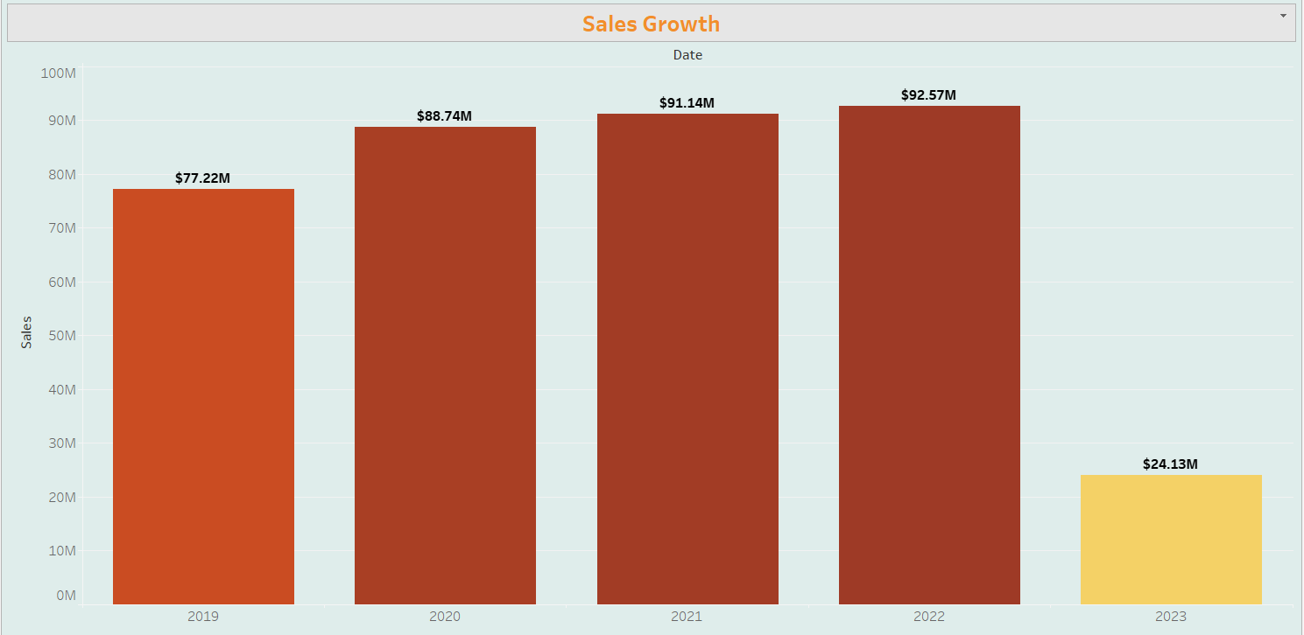
3. Sales Growth by Year:
Sales Growth shows – Year Wise Sales which steadily increasing every year, but it show Sudden fall from 14% to 2% from 1st to next 2 years and reason behind it seems to be our stock being understock for half of our product types.

Slide 6
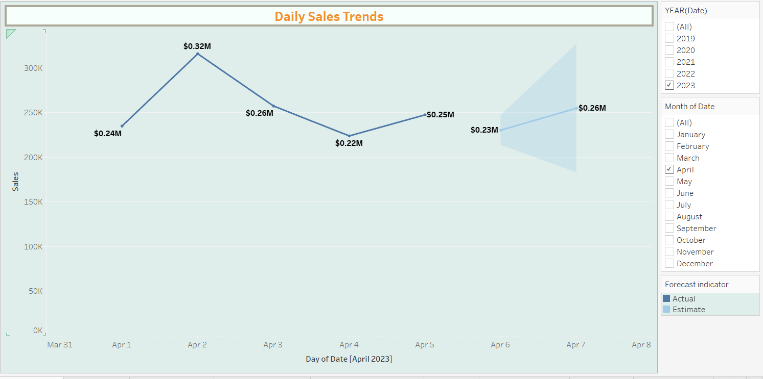
4. Daily Sales Trends:
Daily Sales shows steady growth every Year averages from 0.25M t0 0.35M

Slide 7
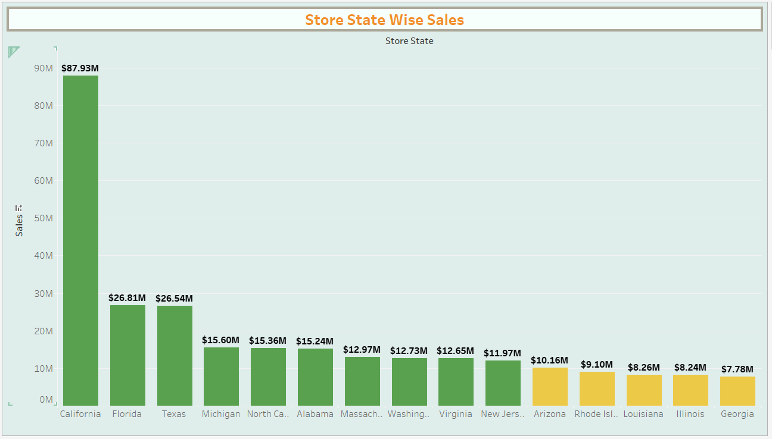
5. Store State Wise Sales:
Below shows our Sales in different Store states and California, Florida, and Texas are our top 3 states in sales performance as they contribute almost 40% of our total sales till date.
Also, Louisiana, Illinois and Georgia are under performing states they contributes only 6% of our total sales till date.

Slide 8
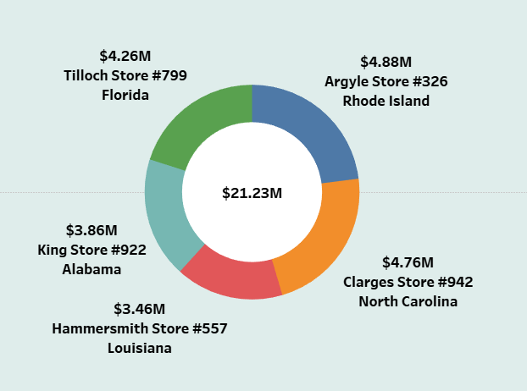
6. Top 5 Stores in Sales:
Below shows our top 5 stores in sales – out of which top 3 stores are from top 10 performing states,
but next 2 stores are from two under performing states in sales , we should make sure these stores should always have stocks.

Slide 9
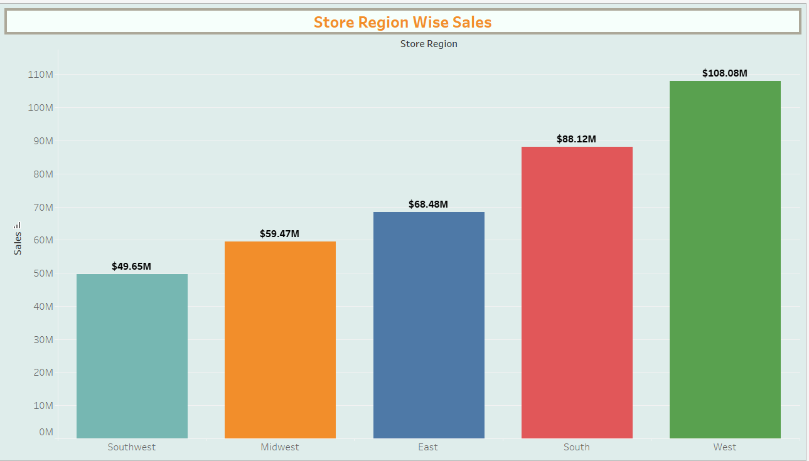
7. Store Region Wise Sales:
Below shows store region wise sales – West region is the best performing region among of them Contributing almost 28% of total sales.

Slide 10
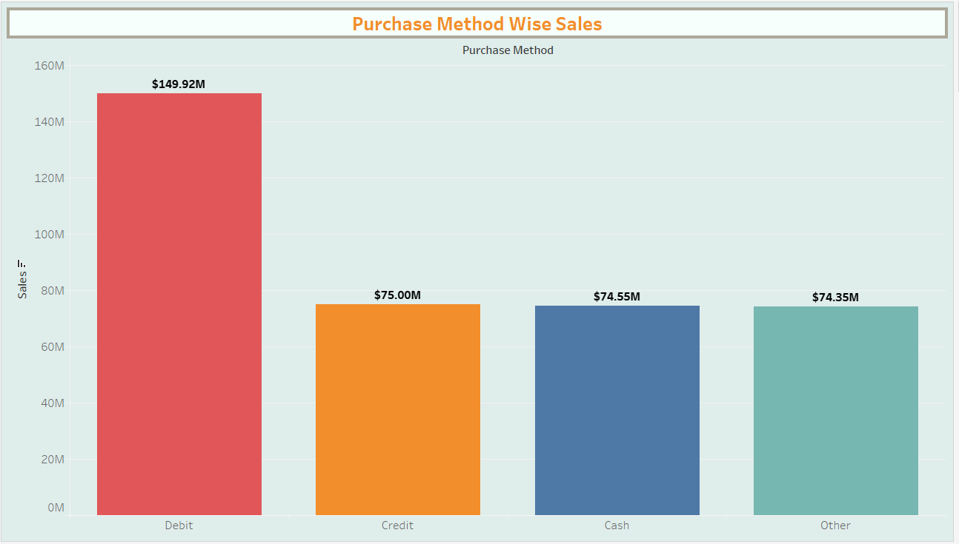
8. Purchase Method Wise Sales
Below shows different purchase methods customers have used so for which shows most of the
Customers uses Debit card purchase method; we could include more purchase methods to make ease in purchase like UPI, and online wallets

Slide 11
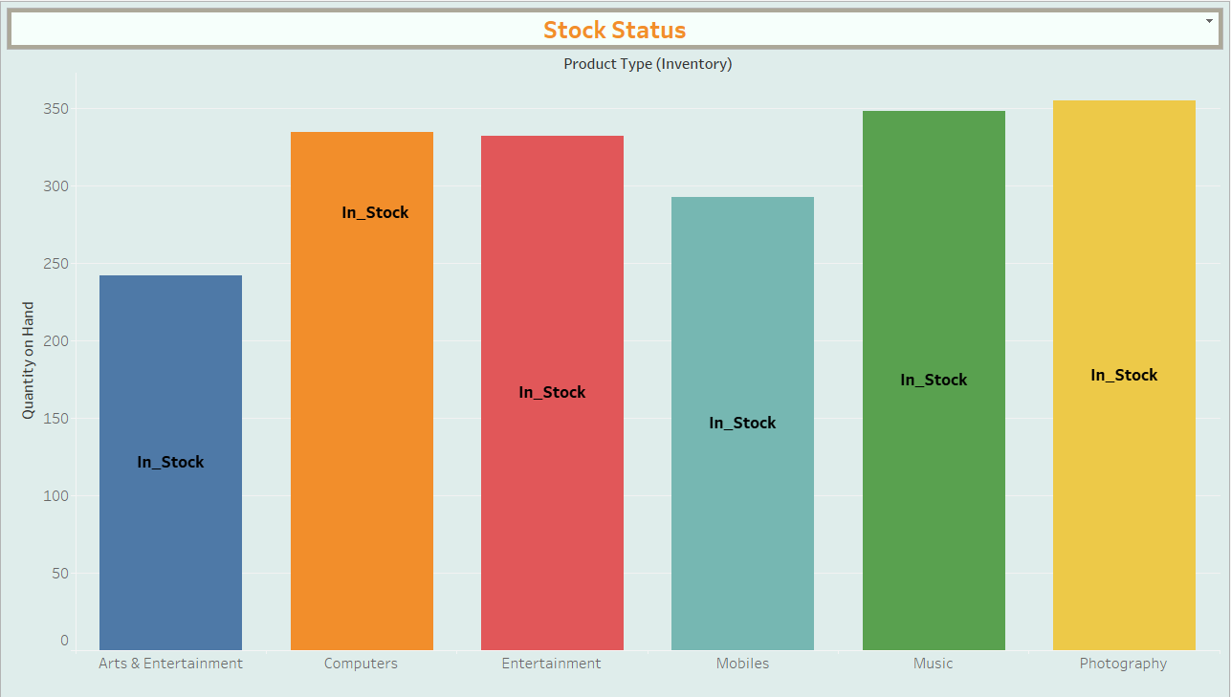


9. Inventory Value and Status
Below show our stock inventory and value – which shows all product type are in stock with adjusted quantity but not enough as half of the product types are still Under-stock refer next visual

Slide 12
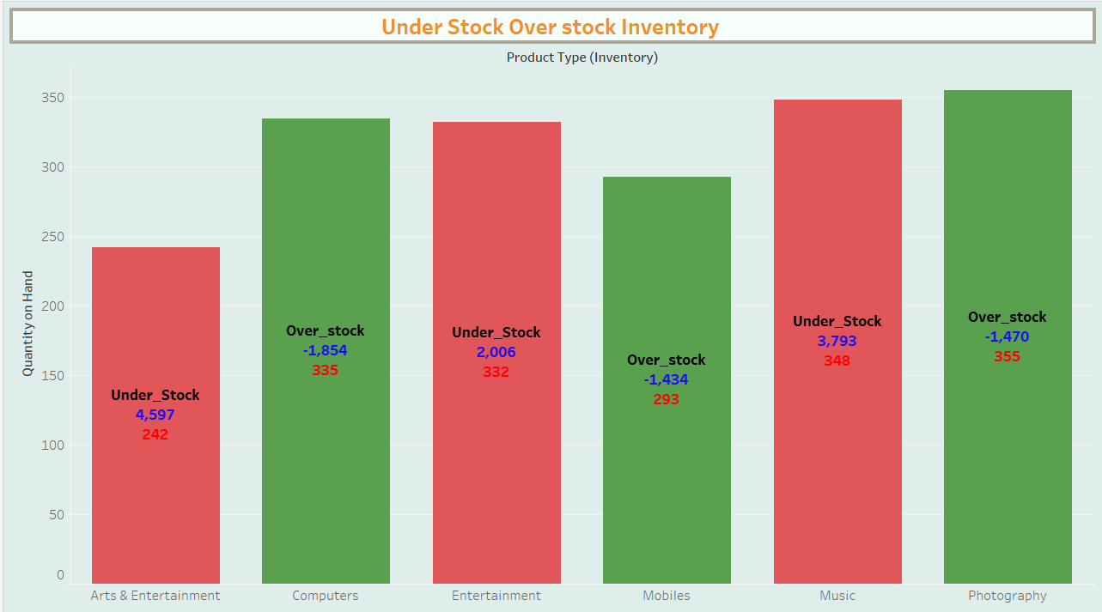
10. Stock Status:
This shows the stock status after adjusting inventory – show half of our product
types are under stock

Slide 13
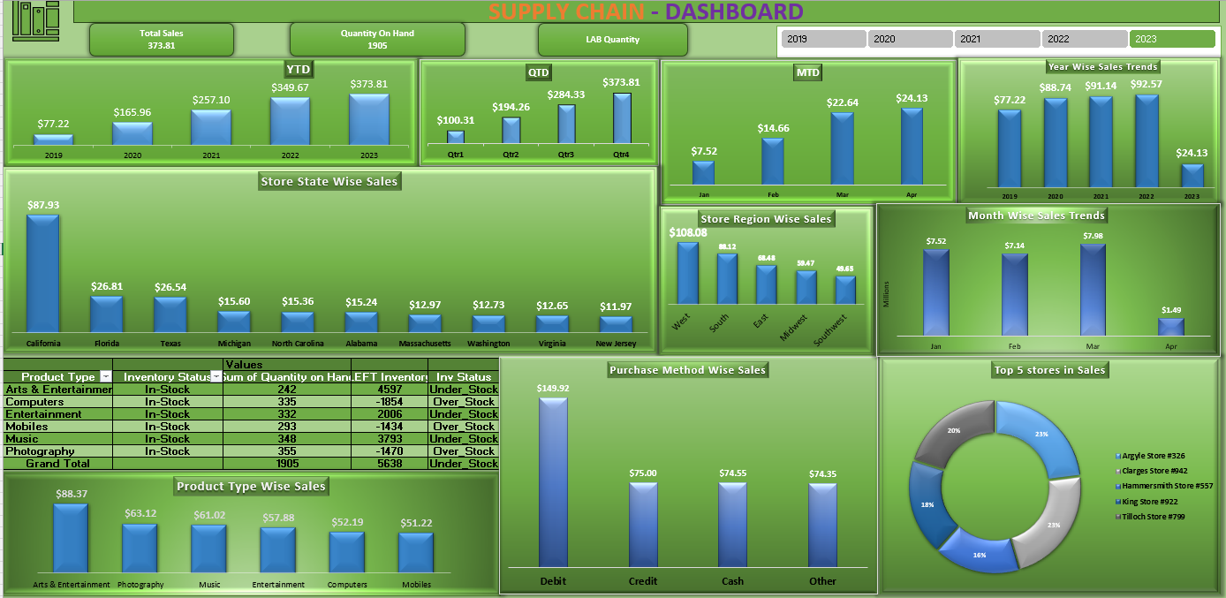
Dashboard 1 - Excel Dashboard

Slide 14
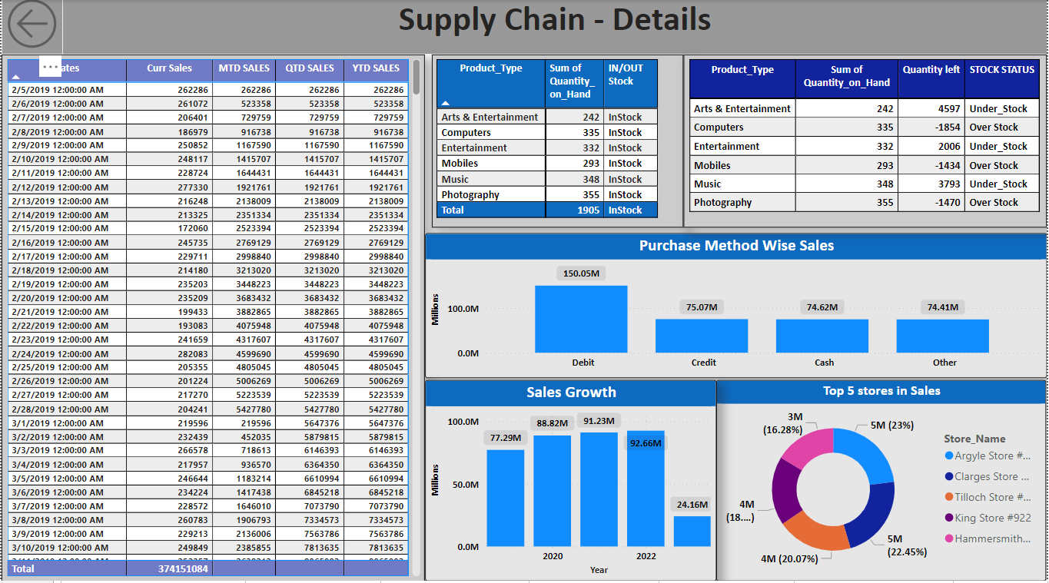
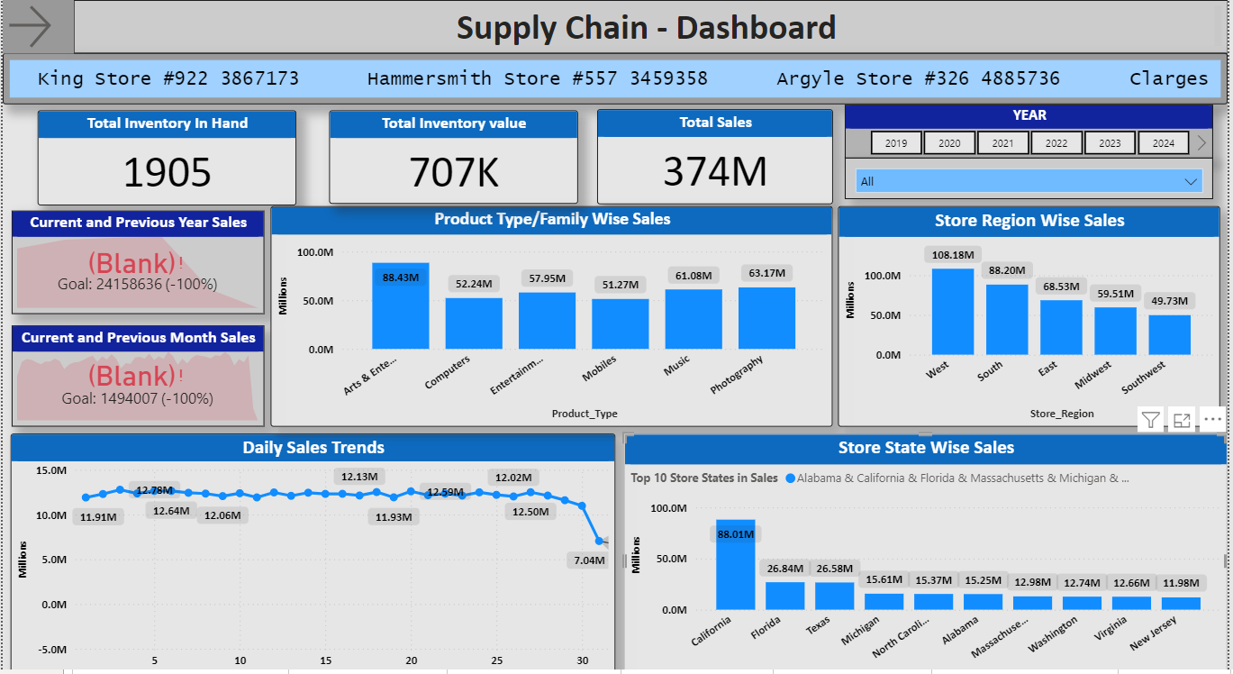
Dashboard2 – Power BI Dashboard

Slide 15
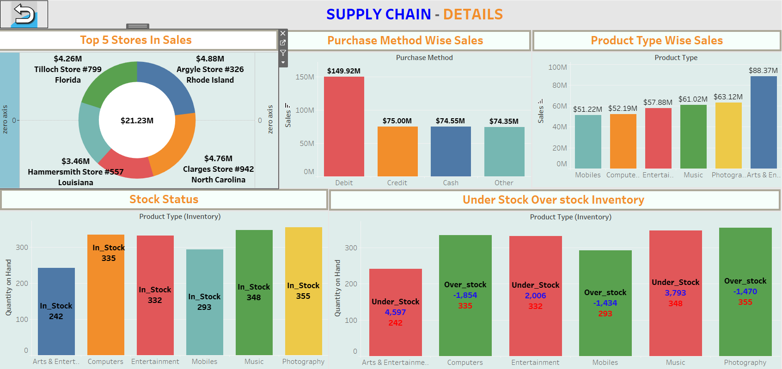
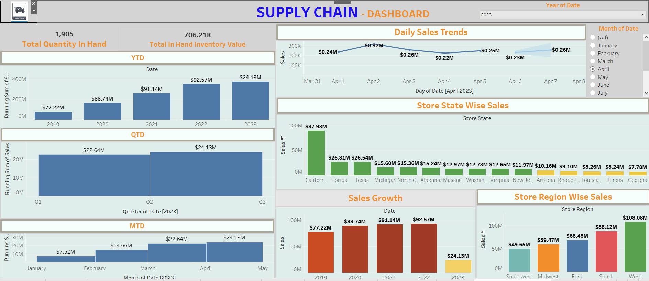
Dashboard 3 – Tableau Dashboard

Slide 16
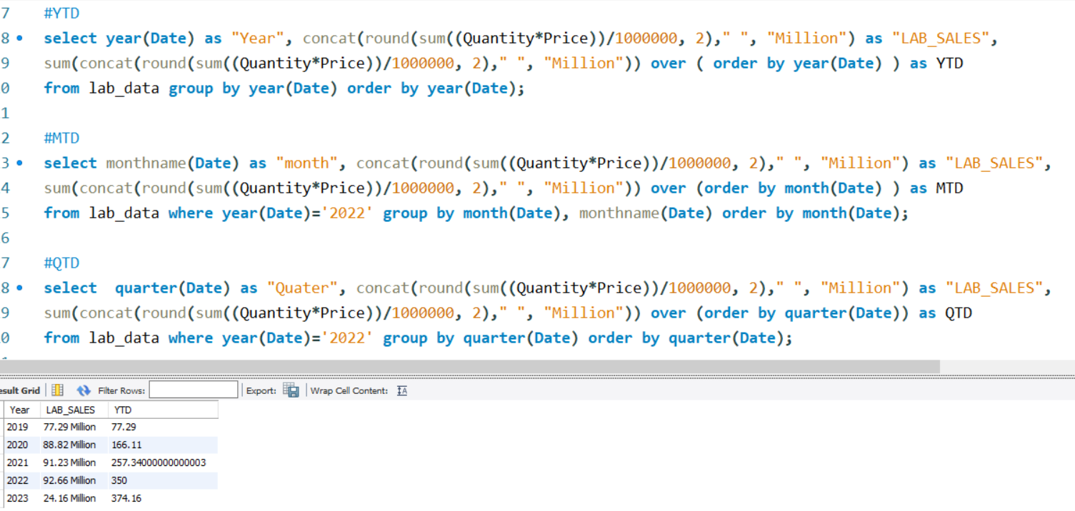
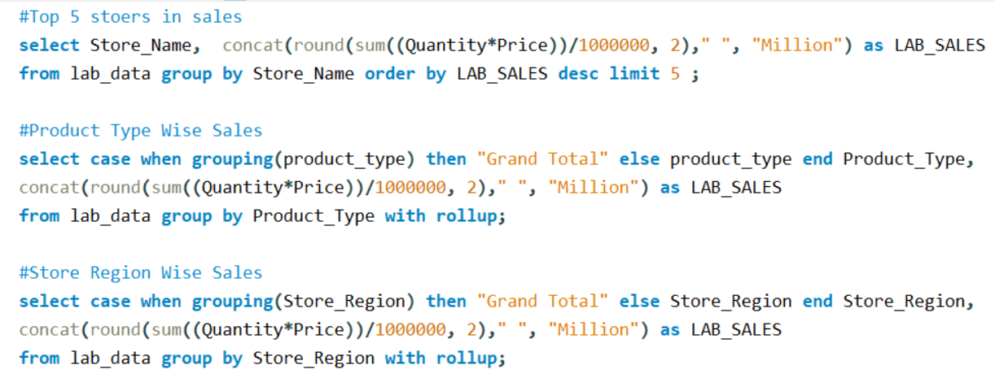
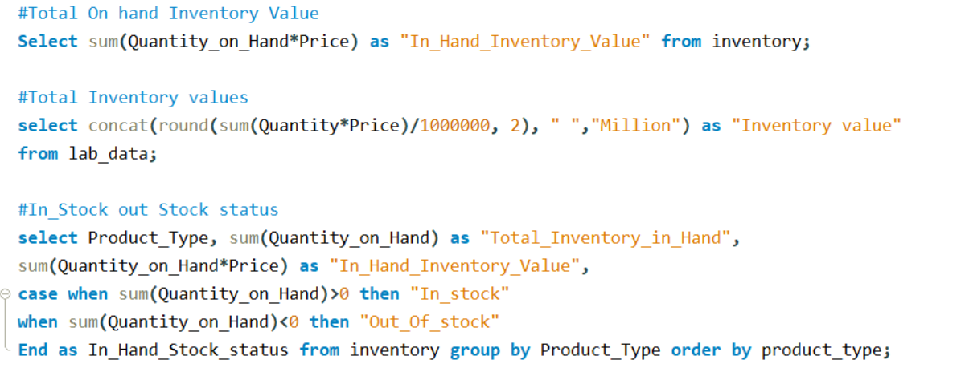
Supporting SQL Queries – Key Performance Indicators

Slide 17
Challenges:
We are not able to maintain our 1st Year Sales growth due shortage of stocks in 2nd Year itself
Stores from out top 10 performing state – not all contributing well to sales
Inventory was always a big issue for us after the 1st of our business

Slide 18
THANK YOU !

